Slide 1
CUNY career launch
2025
Matching Data Wrap Up

Slide 2
Agenda
Goals
Phase Recap
Data Highlights
Lessons Learned
Recommendations for Next Time

Slide 3
Goals table
Newly introduced process: ​
Technical Walkthroughs were "mandatory"
Tried out using the webinar feature during walkthroughs
New one page handout for employers on matching process
Phase | Goal
Student Matches Completed | 1,800
Enrolled Day 1 | 1,760

Slide 4
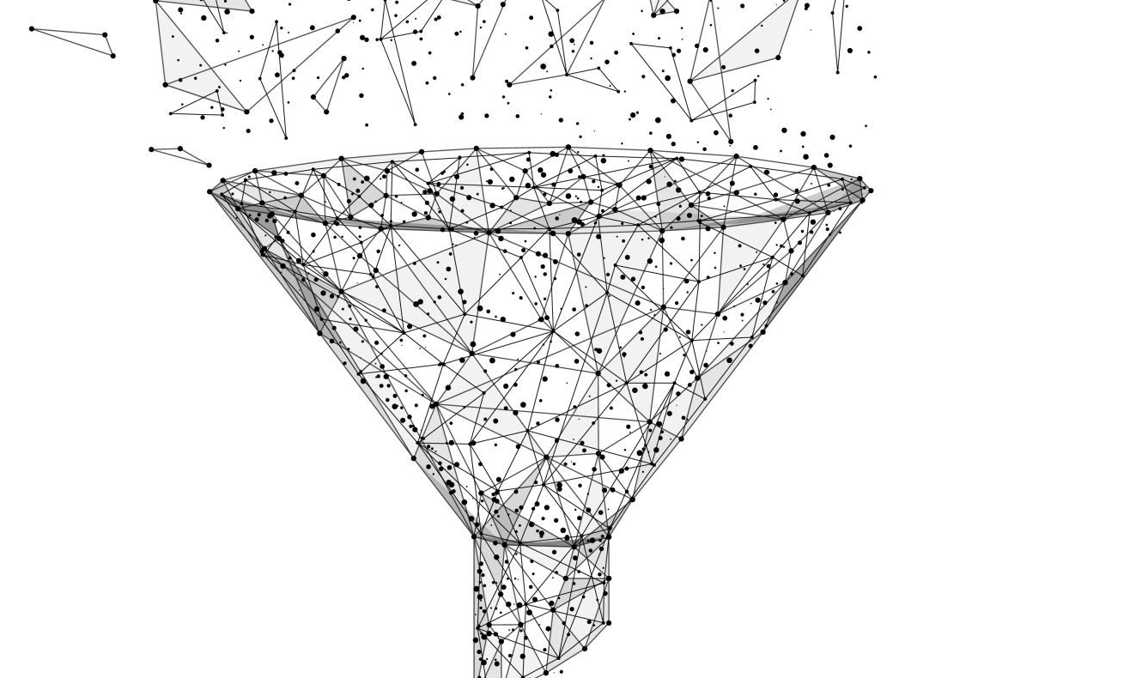
Matching funnel
1,907 Enrolled Students During Pre-Matching
1,901 Matches Completed
1,791 Matches Accepted (as of 6/25/25)
1,786 Students Enrolled on Day 1
Matching Numbers exclude Ed-hub and PEU

Slide 5
What Happened During matching Phase Group?
Matching Fairs
Technical Matching
Final Match Outcome
Technical Matching
Matching Prep
Technical Matching
Hosted technical walk throughs to prepare students to apply for jobs and attend matching fairs
Hosted an employer training
Utilized Iorads to provide additional technical support
3,643 interviews conducted
1,414 students interviewed with at least one organization at the fair (74% of enrolled students)
277 students reported they interviewed outside of fair
Allowed time for "pre-matching" for any long boarding organizations
Supported hubs through bulk matching meetings
65% of matching that was done via bulk matching within InPlace
Tracked student match acceptance forms and change request forms
Hubs processed 93 change requests (53% accepted, 47% denied)
1,901 Matches completed
Notes:
Qualitative Portion: Here include your steps in your process (you may have none or more than 3) for the phase group, This is a descriptive portion on explaining the process. please see Student Selection Example
Final Match Outcome
Acceptance
Rematch
FERPA form
Students hearing from employers

Slide 6
Final matches by hub
Hub | Pre-Matches | Bulk Match | Manual Matches | Rematches | Total
Community And Social Services | 119 | 233 | 32 | 36 | 420
Marketing and Communications | 17 | 410 | 37 | 57 | 521
STEM & Green | 129 | 271 | 19 | 41 | 460
Healthcare | 56 | 315 | 52 | 77 | 500
InPlace Bulk Matching accounts for 65% of all matches
Notes:
Add a column for Total
Asterisk for note on prematching
This table allows us to compare the performance of different hubs in various metrics. By breaking down the data hub by hub, we can identify trends, outliers, and areas of strength or improvement. For instance, we might observe differences in the number of participants invited, offered opportunities, or successfully interviewed across hubs. Additionally, by including percentages or ranking, we can contextualize how each hub performs relative to others.
Example:
CSS Scored(STEP I) with 1,000, Invited(STEP II) 739, Offered(STEP III) 256

Slide 7
Technical walkthrough data
Clearer Expectations → More Participation
Total attendance across all sessions: 1,469 Students (70%)
30% increase in participation over CSF '25
How we set clearer expectations:
  Communicated dates at welcome session
  Sent registration earlier
  Made attendance "mandatory"
Notes:
This table allows us to compare the performance of different hubs in various metrics. By breaking down the data hub by hub, we can identify trends, outliers, and areas of strength or improvement. For instance, we might observe differences in the number of participants invited, offered opportunities, or successfully interviewed across hubs. Additionally, by including percentages or ranking, we can contextualize how each hub performs relative to others.
Example:
CSS Scored(STEP I) with 1,000, Invited(STEP II) 739, Offered(STEP III) 256

Slide 8
Lessons learned
✅What worked:
Setting Clearer Expectations about Attendance at Technical Walkthroughs: Student attendance increased by 30% compared to the CSF cycle.
Bulk Matching: continued to be both effective and efficient.
❌What didn’t work:
Webinar format for technical walkthroughs: not as effective as hoped.
Technical Issues in InPlace: required temporary workarounds instead of permanent fixes.
Student Preparedness: Some employers noted that students lacked adequate interview skills.
Notes:
Please add any lessons that you learned for what did and did not work during the phase group. If there was any Hub interventions that was necessary. Any any niche data points

Slide 9
Recommendations for Next Cycle
Host one walkthrough per hub: Make attendance mandatory to ensure full participation.
Integrate interview skills training: Include a short segment on interview preparation within the walk-through session.
Streamline acceptance and rematch form process

